Slide 1
Digital Marketing
Section 1: Introduction

Slide 2
Digital Marketing Certificate
Principles of Marketing
Advertising
Intro to CSS & HTML
Any WDV/MDT Class (exc. WDV101/150)
Digital Marketing
Customer Relationship Management

Slide 3
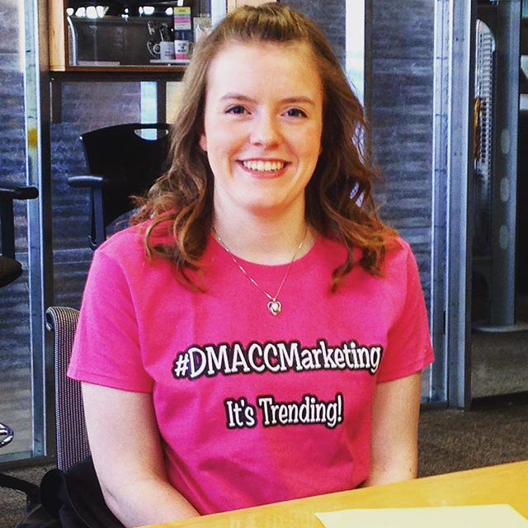
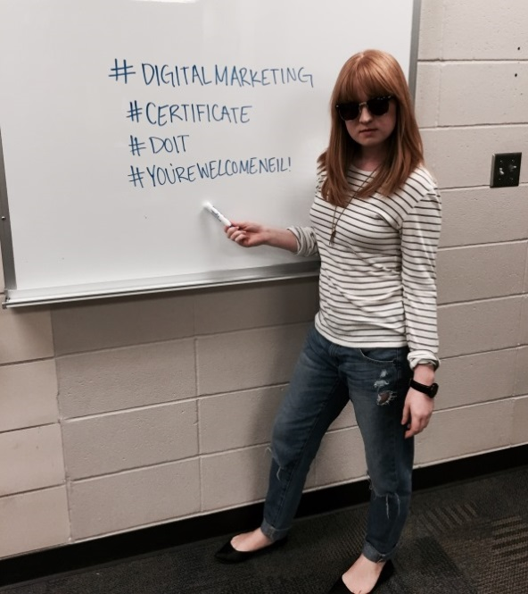
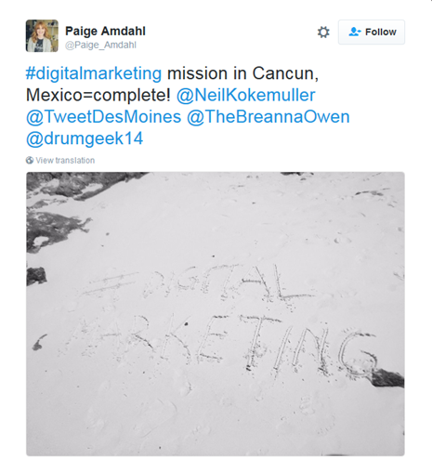

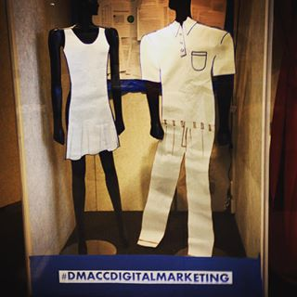

Slide 4
Digital Marketing Definitions
Open to interpretation…
The promotion of products or brands via one or more forms of electronic media. (BusinessDictionary.com)
The practice of promoting products and services using database-driven online distribution channels to reach consumers in a timely, relevant, personal and cost-effective manner. (MobileStorm.com)
A subcategory of marketing which uses digital technology to place and sell products (Investopedia)

Slide 5
More than Just Social Media
Social media is one of the most “popular” elements of digital marketing, but it typically ranks about 4th or 5th on lists of most critical in company digital marketing needs or interests
You can get pigeonholed as a “social media specialist” without broader digital skills (can limit career development as this is an entry-level role)

Slide 6
Digital Marketing vs. Emarketing & Internet Marketing
Digital Marketing is the broadest (and trendiest) term currently
Internet Marketing is a major element of digital marketing, but is Web-specific
Emarketing is often used interchangeably with digital marketing, but is also more associated with Internet or Web marketing
GRAPH ON SEARCH TRENDS SINCE 2004

Slide 7
Elements of Digital Marketing: Oxford Learning Lab
Web (Including Content)
Mobile
Social Media
E-mail
Web Analytics
SEO
PPC
Web Usability

Slide 8
Class Sections
1: Introduction
2: Web
3: SEO & Content Marketing
4: Social Media Marketing
5: CRM & Email Marketing
6: Mobile Marketing
7: Digital/Online Advertising

Slide 9
Importance of Digital Marketing
Projected to reach $100 billion annual expenditure in 2019 (surpassing TV at $87B that year)
Fastest growing segment: Mobile Marketing (About 72% of digital spending by 2019)
Over 50% of all marketing jobs now require technical skills
Top jobs (in order) in 2018, according to Digital Marketing Institute: CX (UX), Sales Enablement, SEO Specialist, Growth Specialists (ie. Analytics), Personalization Strategists
Many large companies (ie. Marriot and Delta Dental) now have CIOs (tech execs) reporting to Chief Marketing Officer

Slide 10
Skills Application
Entrepreneurial – Small business operator
Entrepreneurial – Consultant in any specialized area (content, SEO, online, mobile, social media, CRM, etc.)
Marketing agency (generalist or specialist)
Company marketing department (generalist or specialist)
Freelance (Web developer, content marketer, content writer, etc.)
Front desk operations (small business)

Slide 11
Why Digital Marketing Matters?
Tight marketing budgets
Interaction and engagement
Analytics
Immediacy
Accountability
Awareness with digital audience

Slide 12
Meeting Audience on their Turf
Business marketing and service functions are focused on connecting with target customers through the channel and the times the market dictates
Eg. Growth in mobile marketing driven much by younger audience reliance on cell phones for communication.

